Slide 1
Real Estate Sales
(2001-2020)
Ikonkar Khalsa & Matthew Gregorio

Slide 2
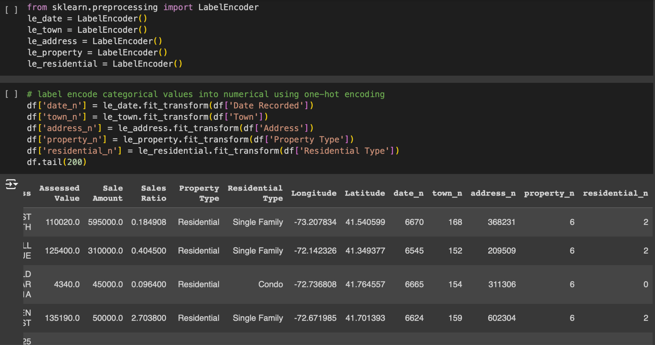
Label Encoding

Slide 3
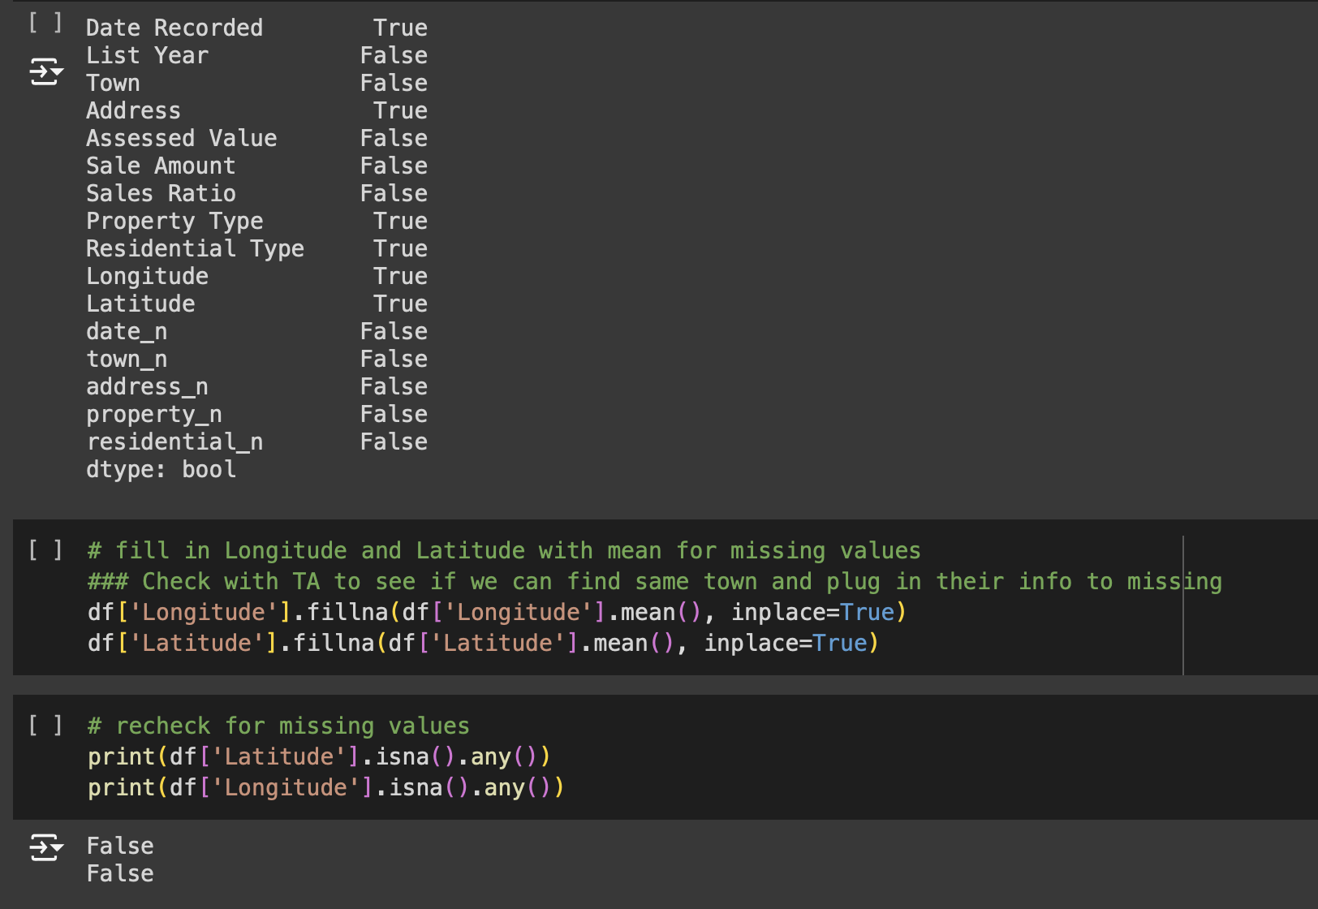
Missing Values

Slide 4
Define x and y

Slide 5
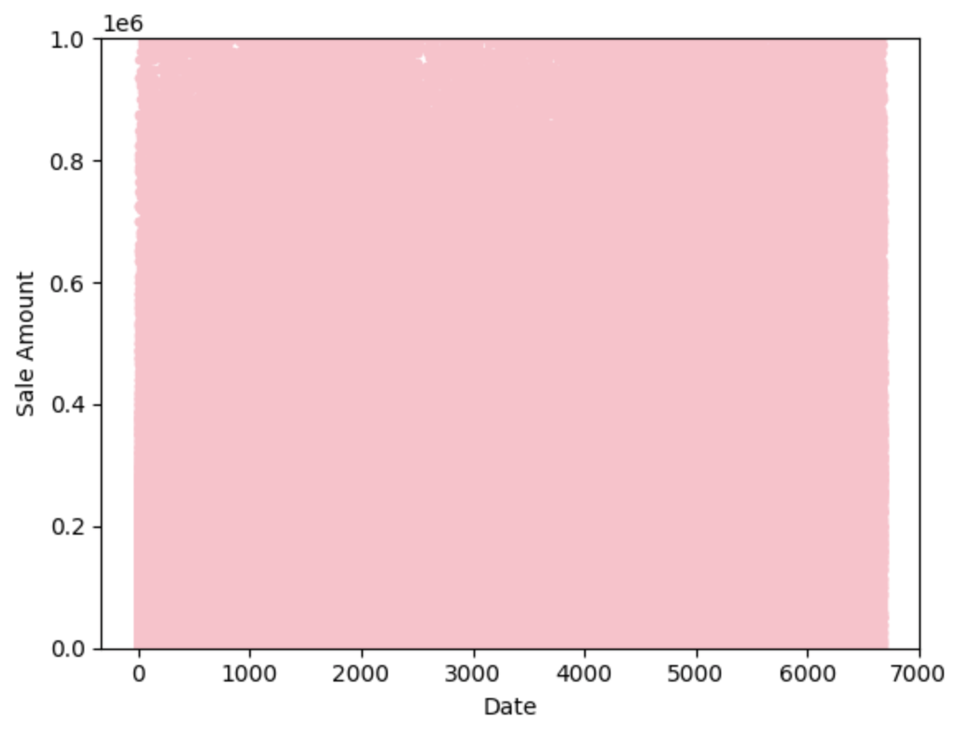
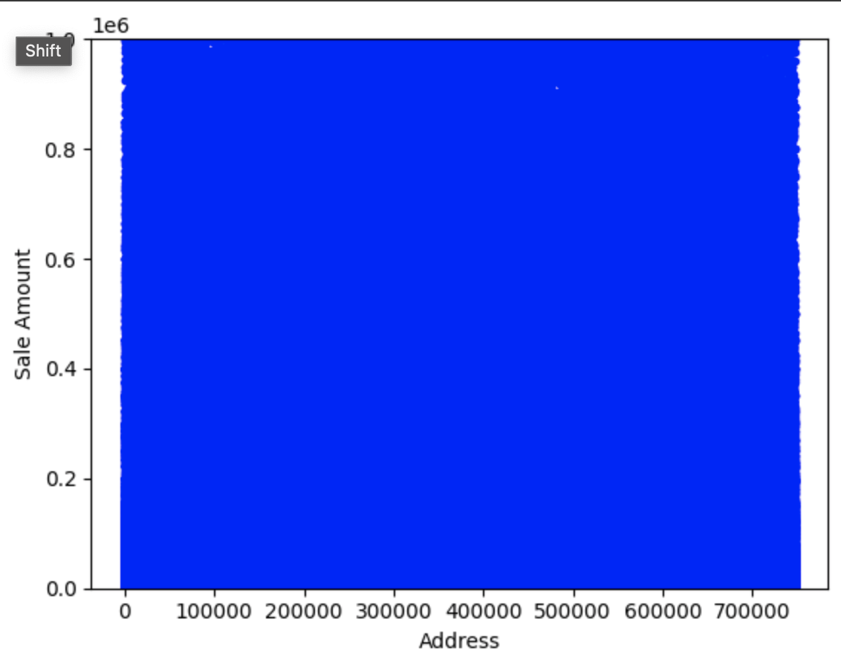
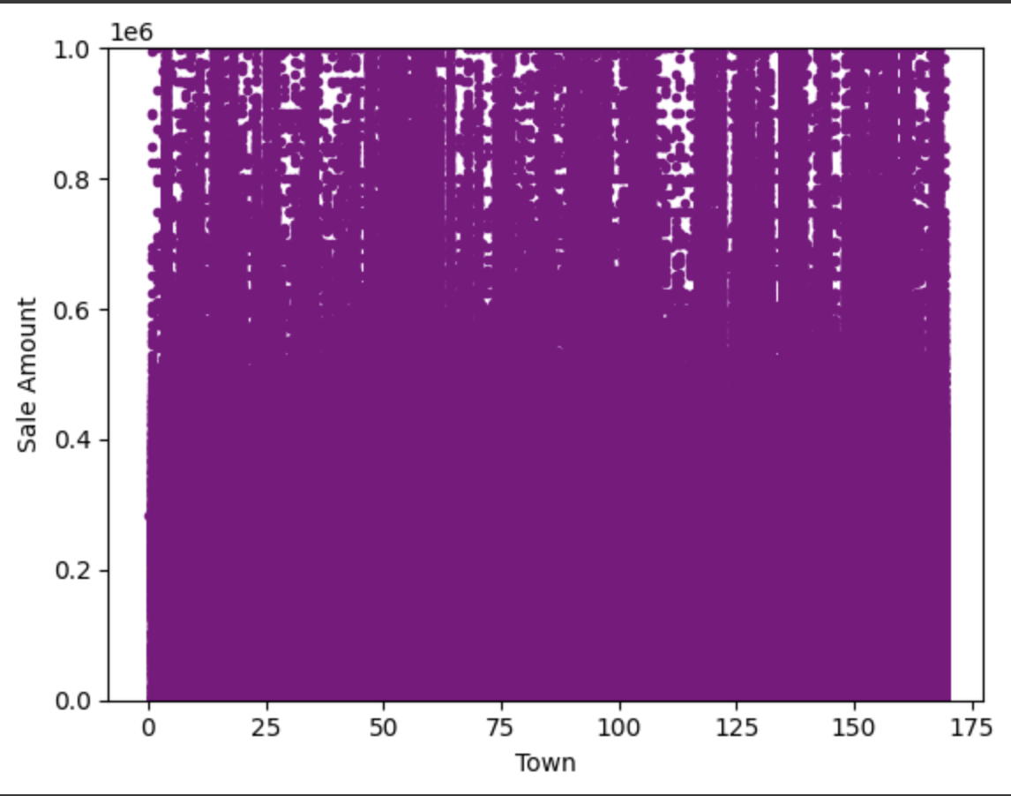
EDA - Correlation of each feature to Sale Amount

Slide 6
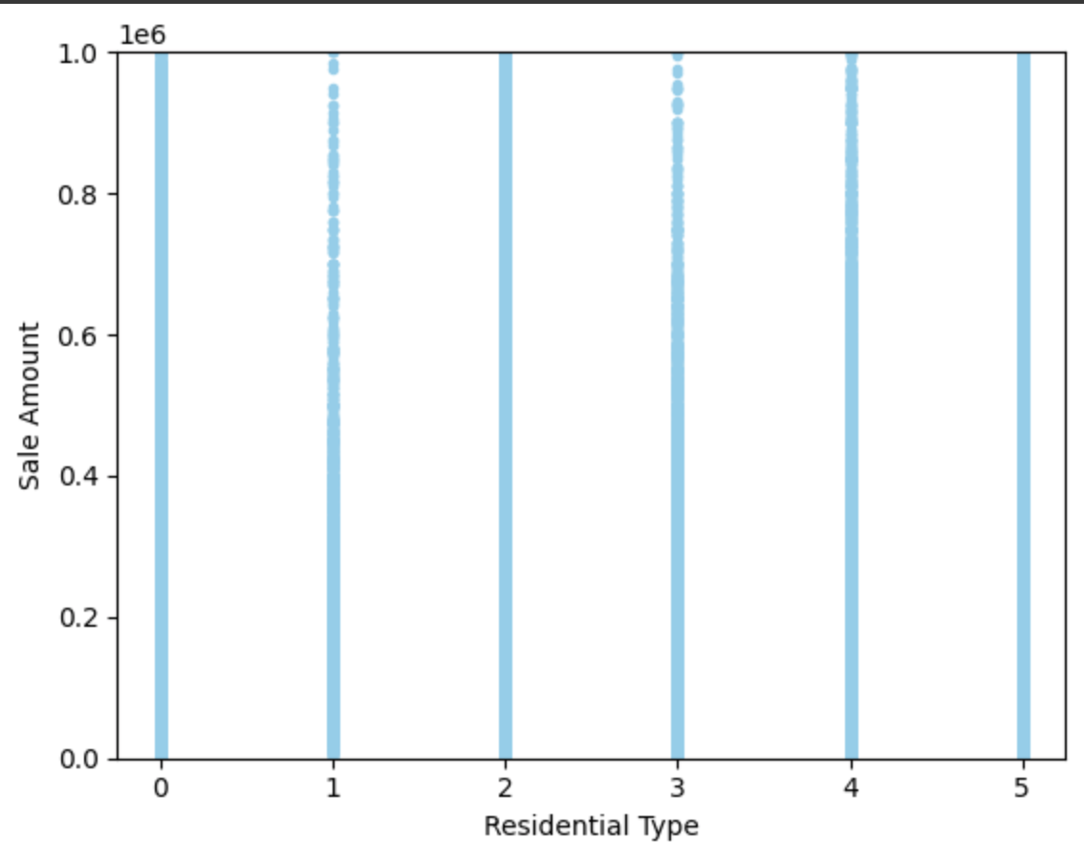
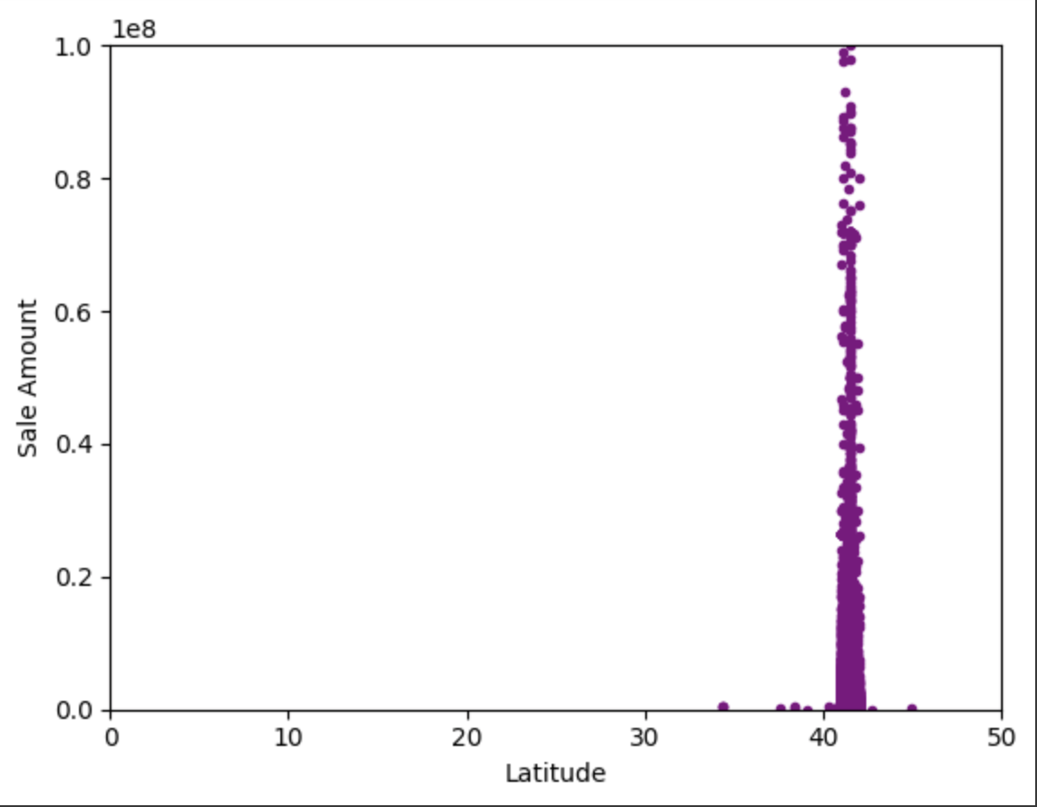
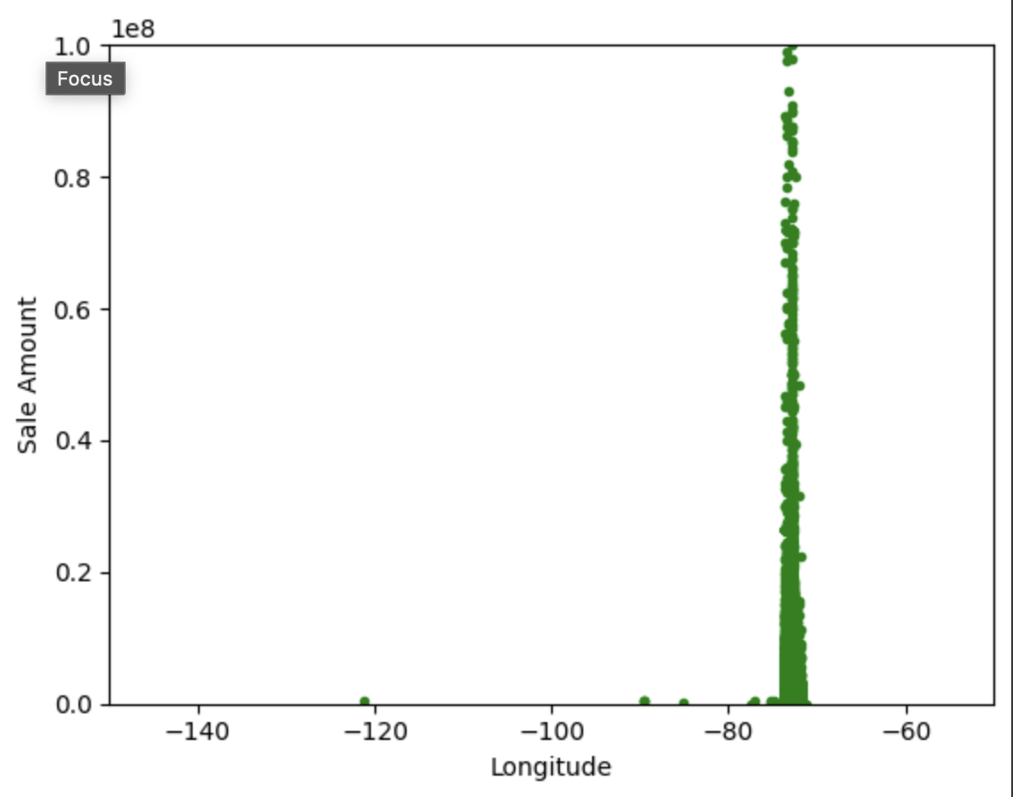
EDA - Correlation of each feature to Sale Amount

Slide 7
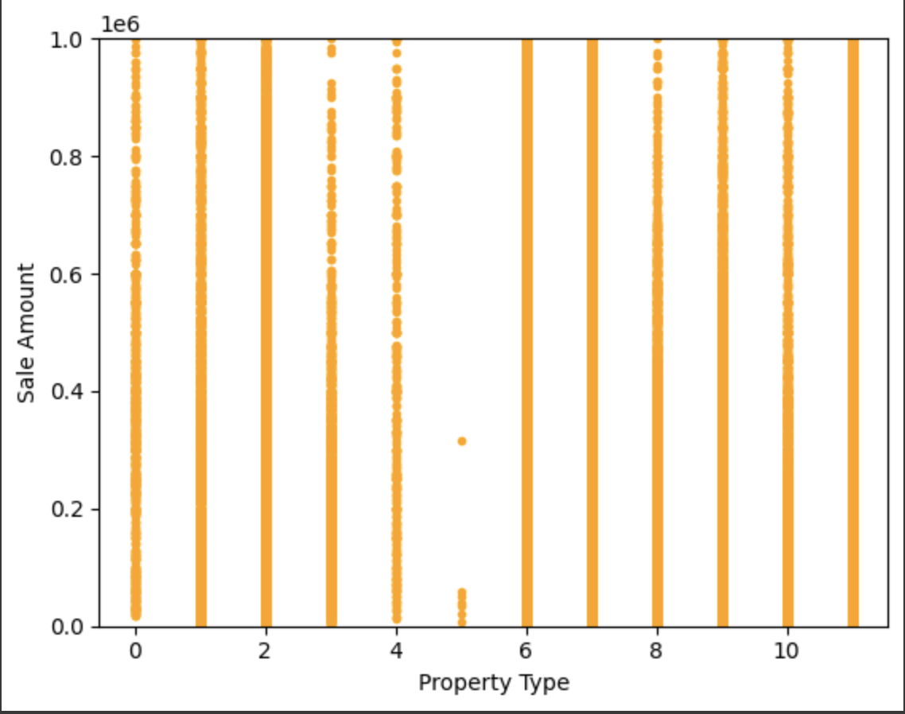
EDA - Correlation of Property Type to Sale Amount

Slide 8
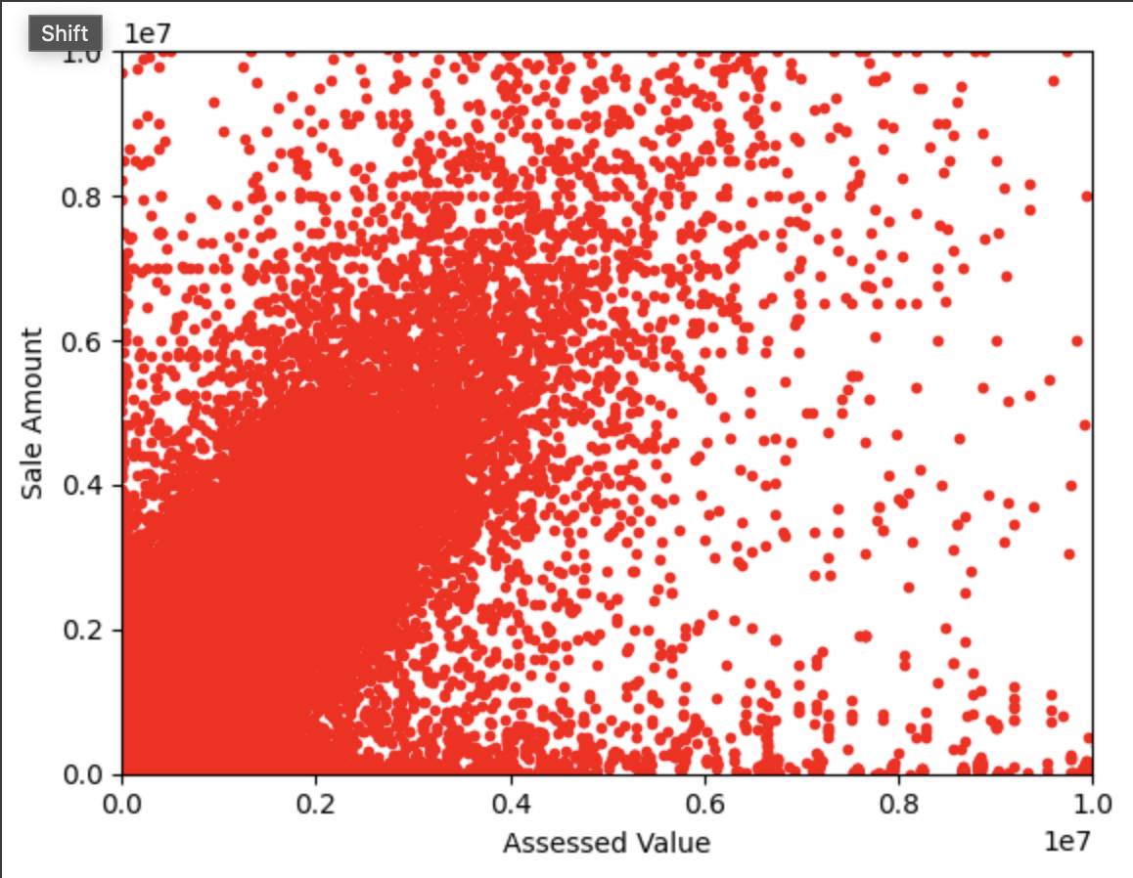
EDA - Correlation of Assessed Value to Sale Amount

Slide 9
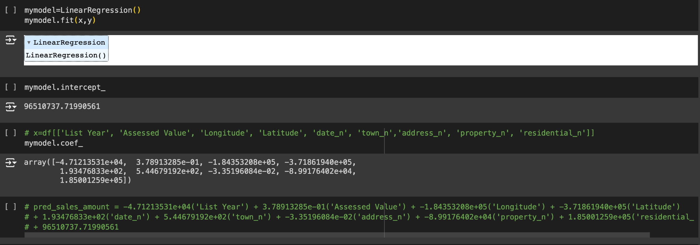
Linear Regression

Slide 10
Next Steps
Other types of regression analysis (ridge, lasso, decision trees, etc)
Feature Analysis
Market Trend Analysis
Time series
Check correlations numerically

